Slide 1


ASPIRE BI
Talend process architecture
April 2022

Slide 2

PROCESS OUTLINE
A complete flow of Talend process starts from Architecture, Workflow, Documentation, Support …
Talend Architecture
Snowflake Accounts
User Roles
Remote Engines
Access, Schedules and Logs
Support Model
2

Slide 3



TALEND CLOUD ARCHITECTURE
April 2022
For illustrative purposes only

Slide 4

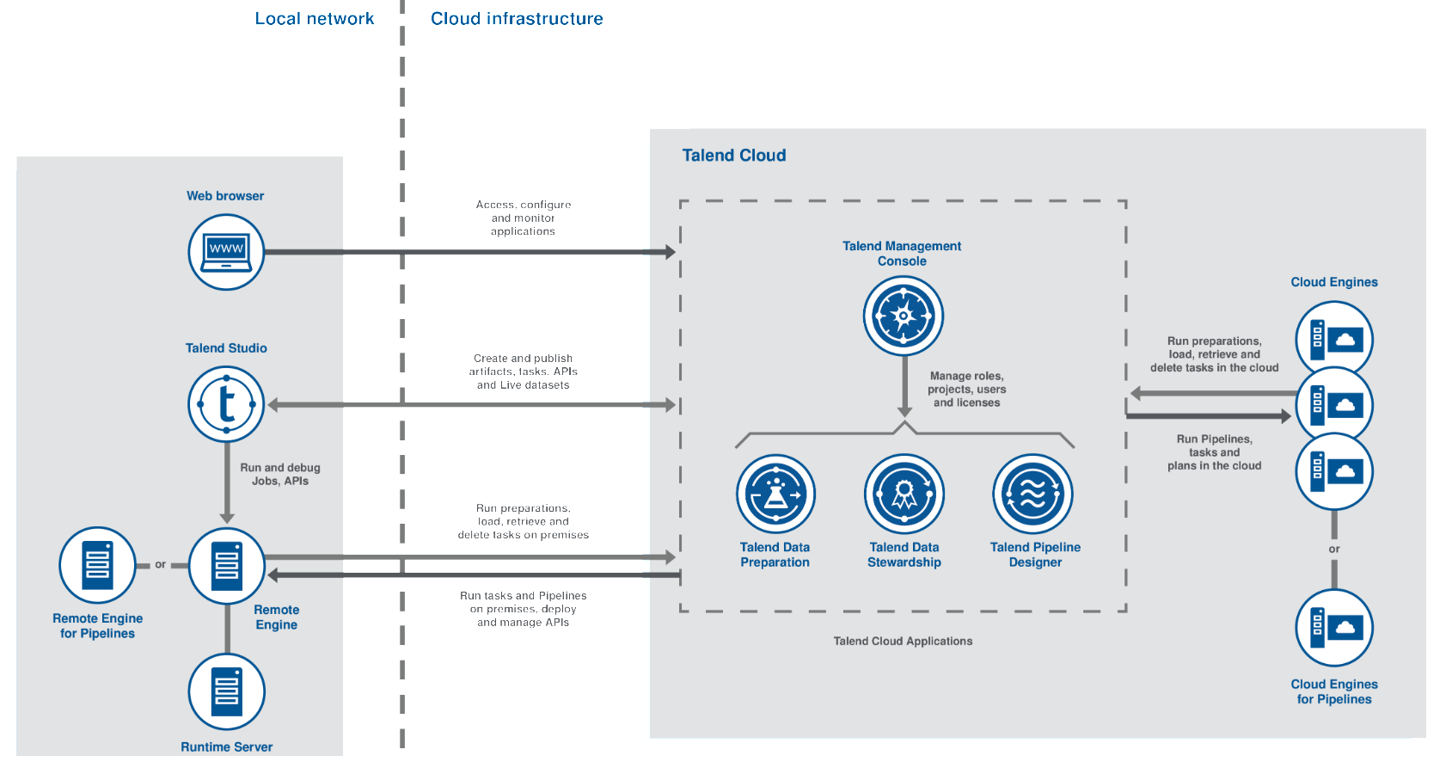
Talend Cloud Architecture
Push and Pull
Changes

Slide 5
SNOWFLAKE SERVICE ACCOUNTS
April 2022
For illustrative purposes only

Slide 6
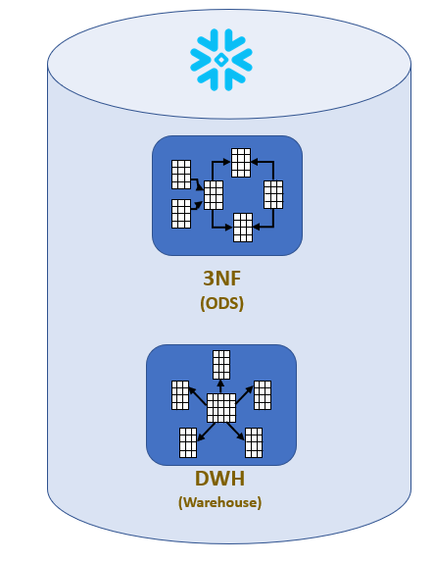


Snowflake Service Accounts
Snowflake Prod Service account (svc_talendd@intlsos.com)
Talend
Secured by
Azure Private Link
Snowflake Non-Prod Service account (SVC_Talend_NonProd@Isosdev.com)
Snowflake DB

Slide 7
USERS, PROJECTS AND Roles
April 2022
For illustrative purposes only

Slide 8
Users and Projects
List of Users
Arjun AB
Muthuraj Perumal
Manish Bhatt
Talend Monitor
Guido Fischer
List of Projects and URL
ISOS_AspireBI_China_Migration
URL: https://abarjun@bitbucket.org/abarjun/isos_aspirebi_china_migration_new.git
ISOS_AspireBI_Project
URL: https://abarjun@bitbucket.org/abarjun/isos_aspirebi_project_new.git
ISOS_AspireBI_Snowflake_Migration
URL: https://abarjun@bitbucket.org/abarjun/isos_aspirebi_snowflake_migration_new.git
ISOS_Moscow_Project
URL: https://abarjun@bitbucket.org/abarjun/isos_moscow_project_new.git

Slide 9





User Roles
Data Preparation
Arjun AB, Manish Bhatt
Operations Monitor
Talend Monitor
Administrator
Arjun AB
Studio Developers
Muthuraj Perumal, Arjun AB
Data Stewardship
Muthuraj Perumal, Guido Fischer

Slide 10
REMOTE ENGINES
April 2022
For illustrative purposes only

Slide 11

Production Remote Engines
On-Premise
Cloud
Moscow Remote Engine
(mow1vaptld001)
Azure Remote Engine
(aldtalendprod-sea)
Azure Remote
Engine Cluster
(aldtalendjobprod-sea)
China Remote Engine
(SHA1VCICRPT001)
Global Remote Engine
(PHL1VAPTRE001)

Slide 12
UAT Remote Engines
On-Premise
Cloud
Moscow Remote Engine
(10.35.17.44)
Azure Remote Engine
(aldtalendstg-sea)
China Remote Engine
(10.23.8.47)
Global Remote Engine
(AZ1T01ABI003)

Slide 13
LOGS, JOBS, SCHEDULES AND ALERTS
April 2022
For illustrative purposes only

Slide 14
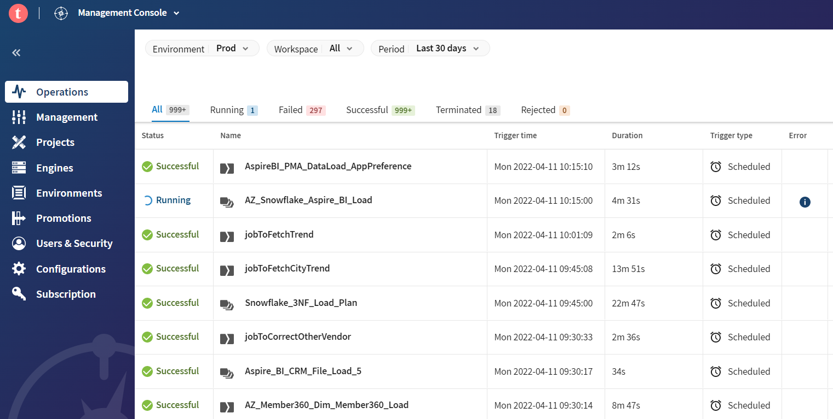
Logs and Jobs
Talend Execution Logs:
Job List:

Slide 15
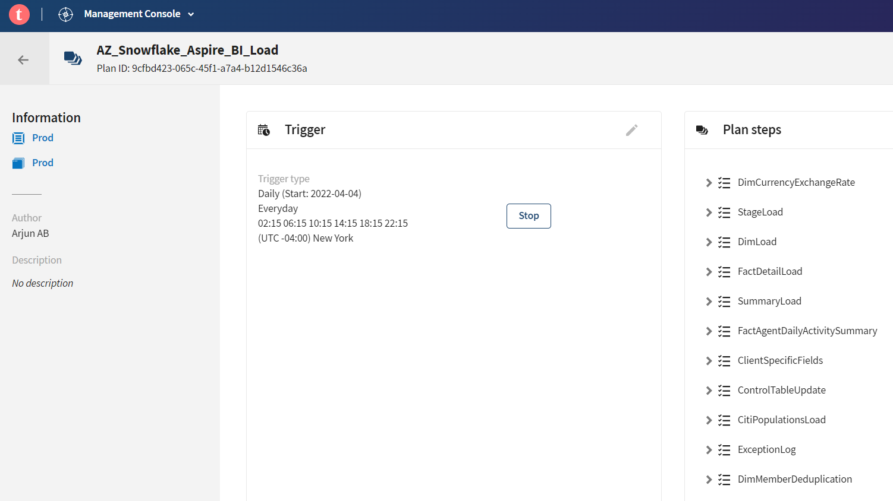
Schedules

Slide 16
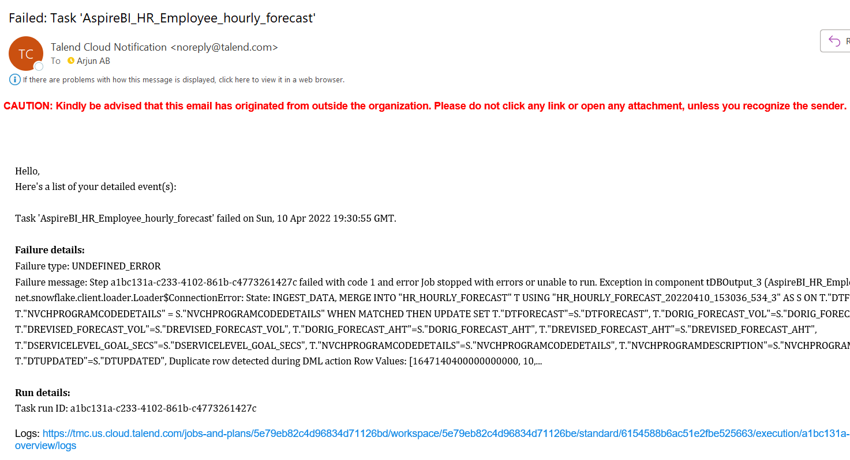
Alerts

Slide 17
ACCESS TO TALEND
April 2022
For illustrative purposes only

Slide 18


Access to Talend
Jira request to Administrator
Administrator
User
Access to Talend Console
TMC
Talend Management Console (TMC) Link: https://tmc.us.cloud.talend.com/

Slide 19
SUPPORT MODEL
April 2022
For illustrative purposes only

Slide 20
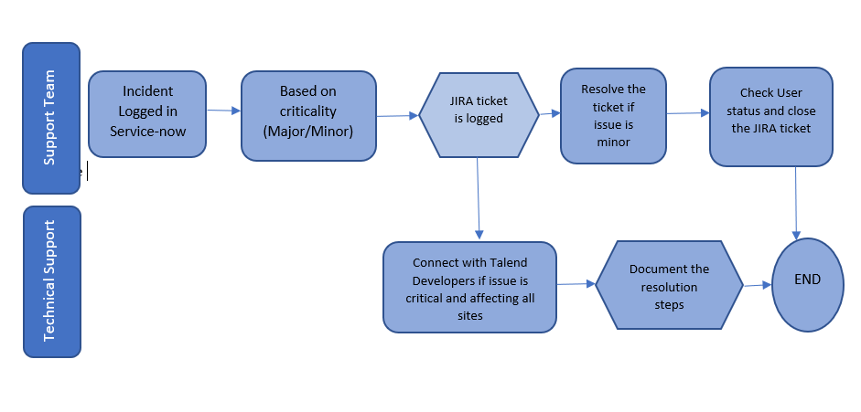
Support Model

